Slide 1
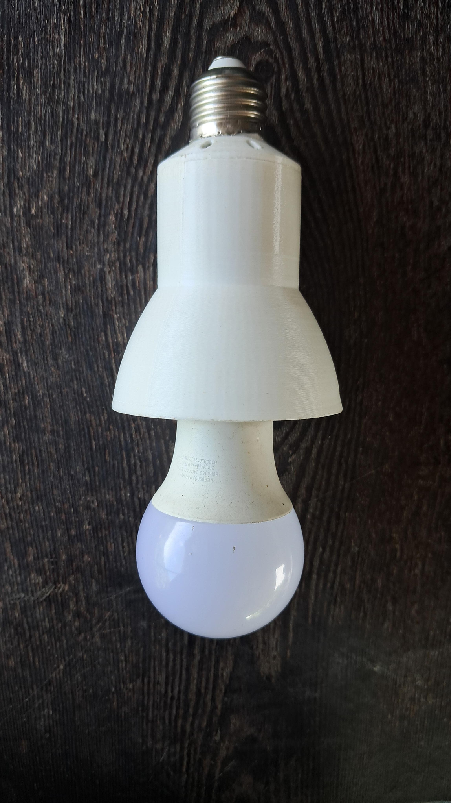
Spark07
Spark07
Smart Glow
Smart light bulb adapter

Slide 2
Content
SmartGlow
01
02
03
04
Introduction
Product Architecture
Circuit
PCB
05
06
07
08
Enclosire
Mobile App
Marketing and Sales
Team

Slide 3
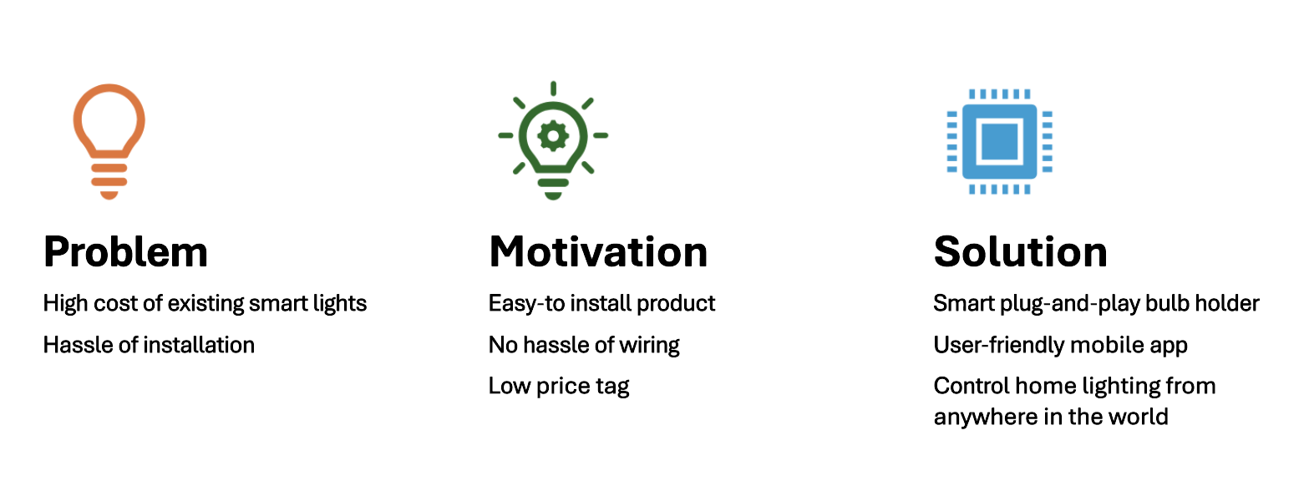
SmartGlow
SmartGlow

Slide 4
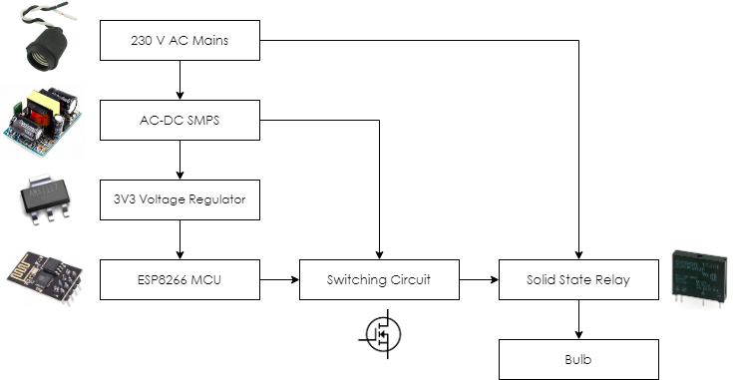
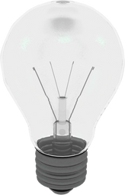
Product Architecture
SmartGlow
User
Mobile App
Server
Daabase

Slide 5
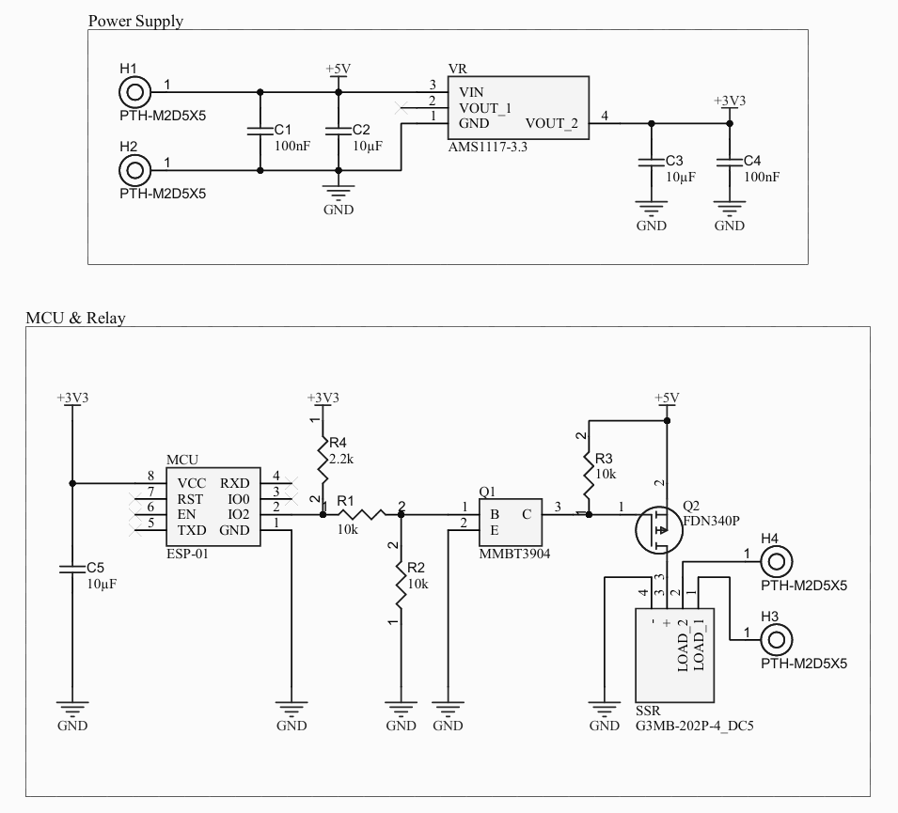
Circuit Schematics
SmartGlow

Slide 6
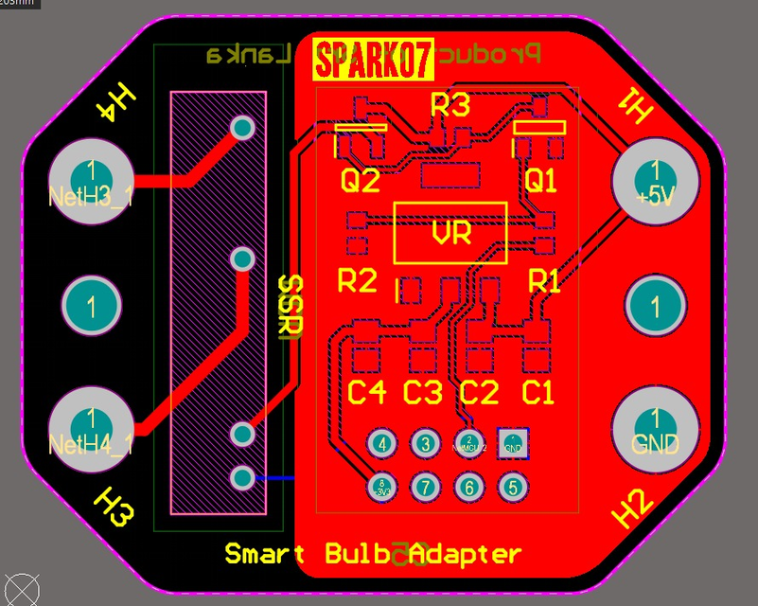
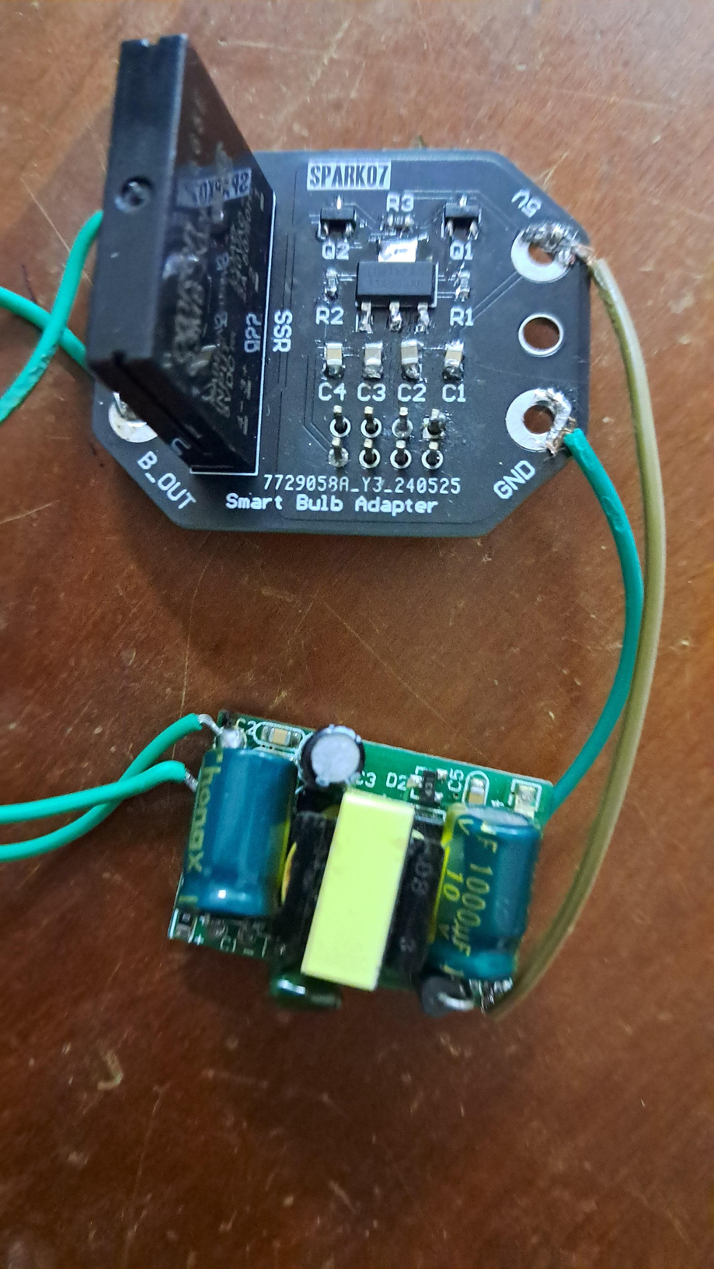

PCB
SmartGlow
Design Software Used:
Altium Designer

Slide 7
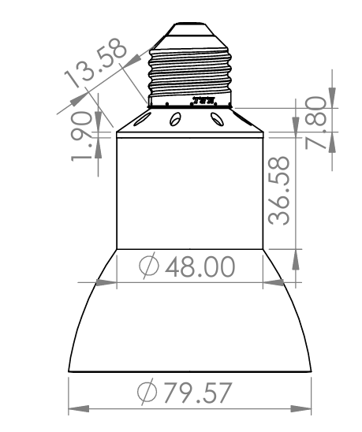
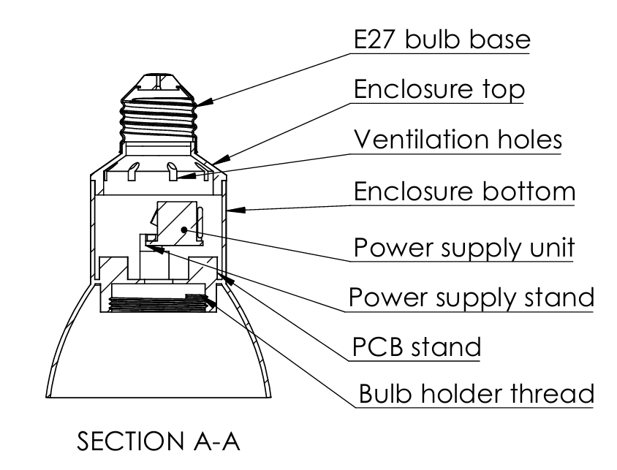
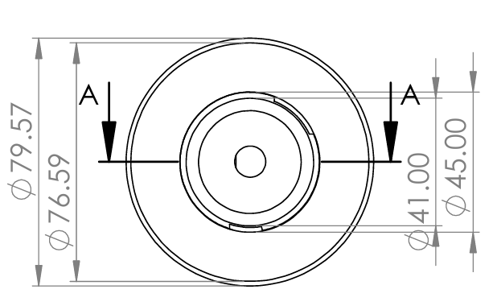
Enclosure Designs
SmartGlow
Side View
Top View
Section View

Slide 8
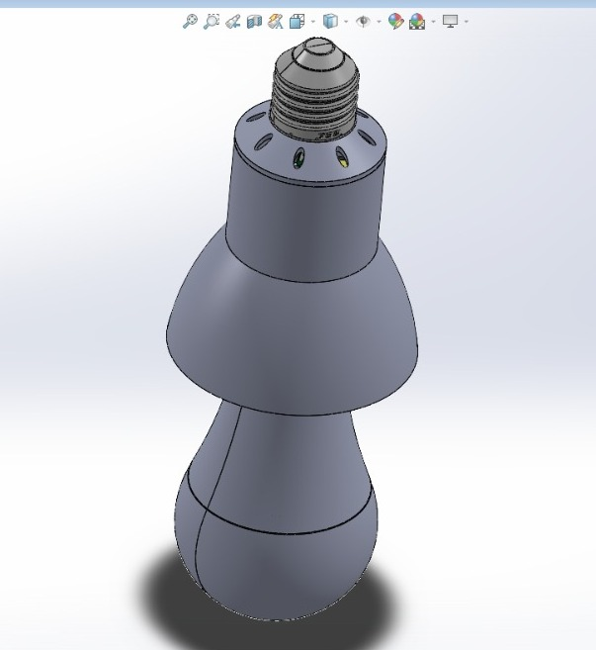
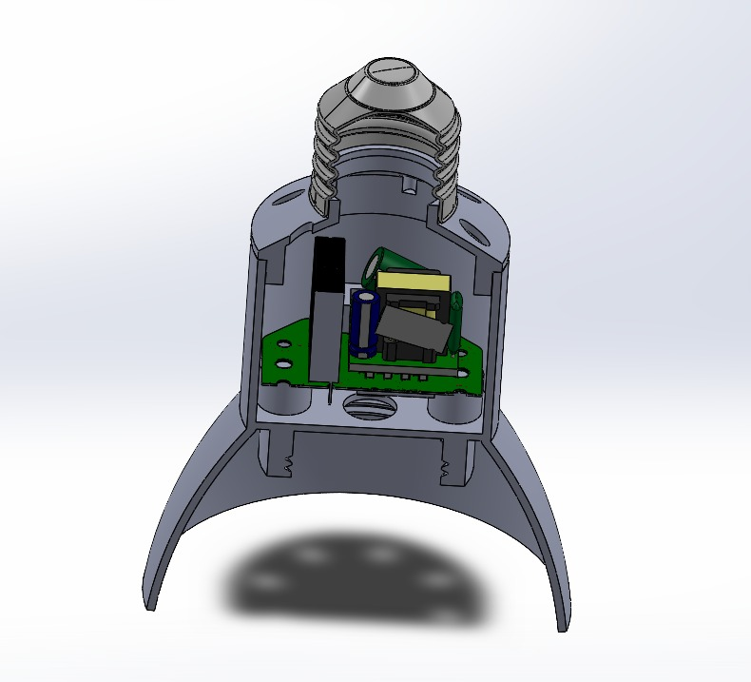

Enclosure 3D Model
SmartGlow
Design Software Used:
SolidWorks

Slide 9
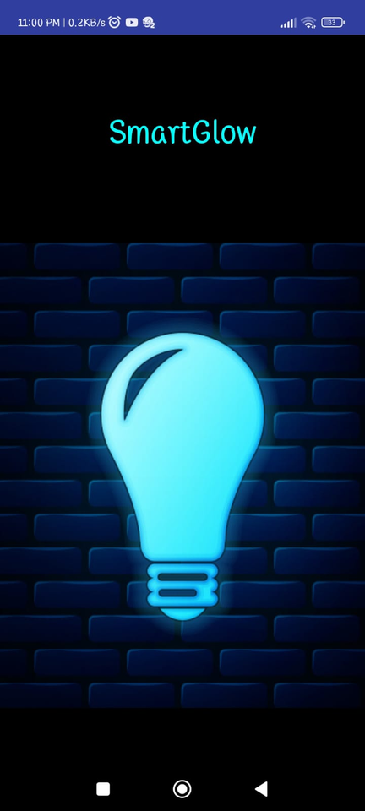
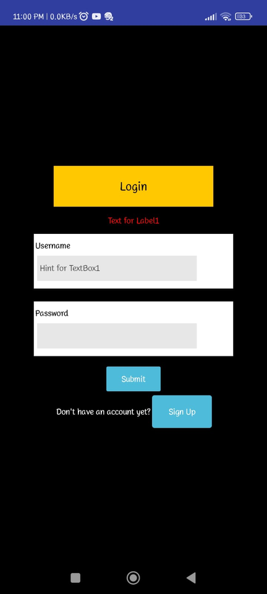
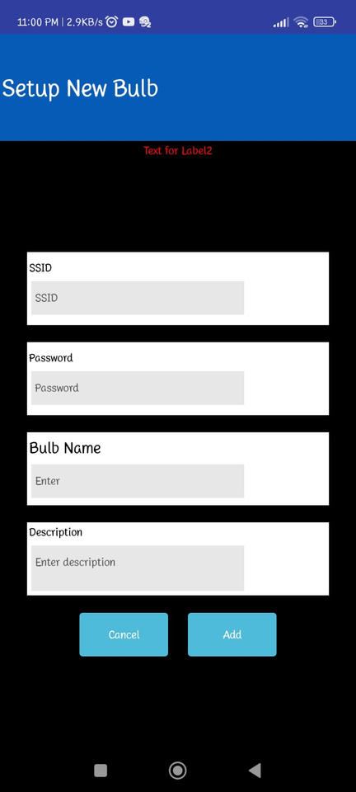
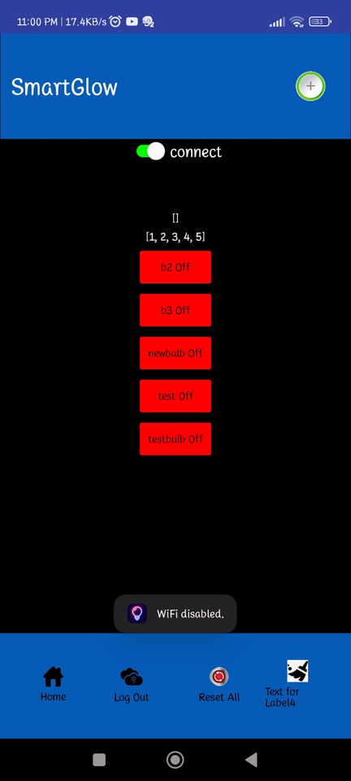
Mobile App
SmartGlow

Slide 10
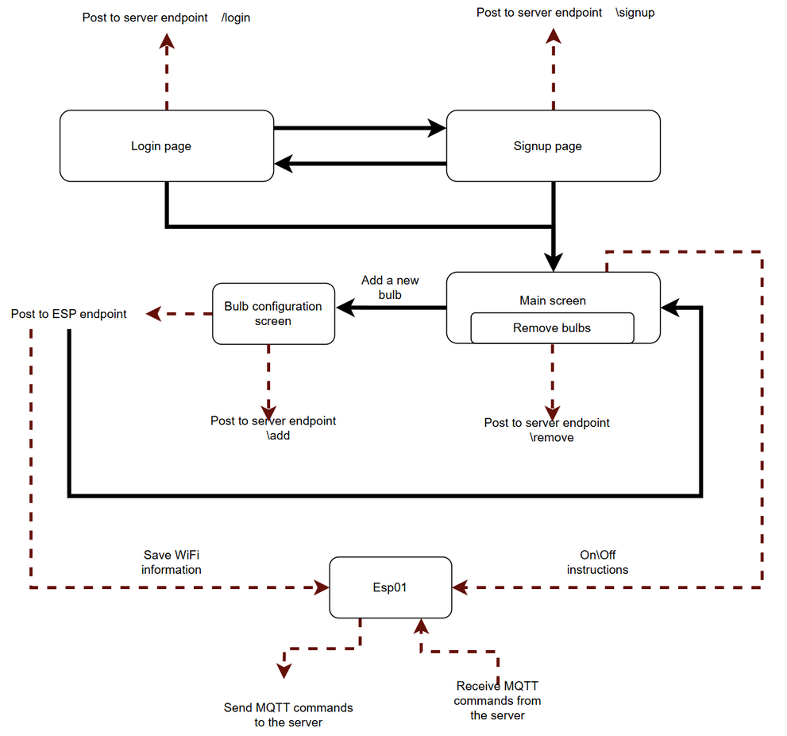
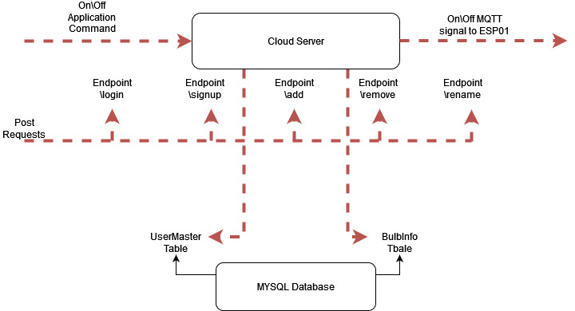
Mobile App Architecture
SmartGlow

Slide 11
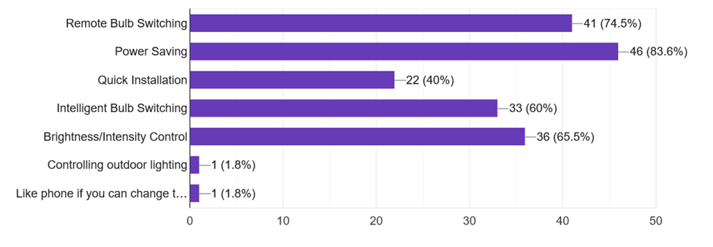
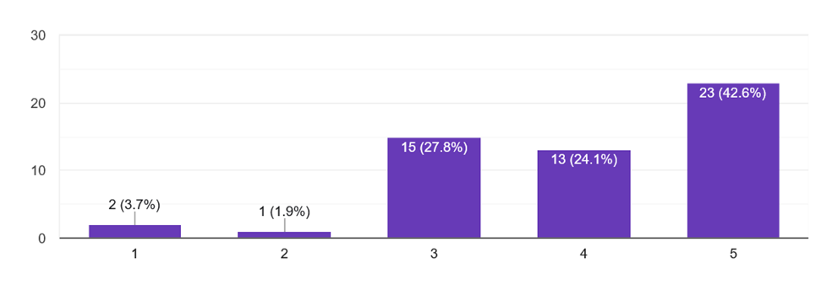
Market Analysis
SmartGlow
According to the market analysis the respondents showed interest in out proposed product and the preffered functionality includes remote bulb switching and power saving. 96% of respondents were not smart bulb owners but were willing to use one.
Functionality Preference
SmartGlow reaches users with an affordable and simple smart bulb solution with mobile app access.
Social media platforms such as Facebook and Instagram are planned for marketing and our aftersales service is planned to include one-year warranty and IoT consultancy
Willinglness to install proposed product

Slide 12
Bill of Materials
SmartGlow
Item | Cost
ESP01-S Microcontroller | 410.00
Solid State Relay | 230.00
230 V AC - 5 V DC SMPS | 270.00
AMS1117 DC 3.3V Regulator | 75.00
FDN340P MOSFET | 40.00
MMBT3904 BJT | 3.00
SMD Capacitors and Resistors | 20.00
Item | Cost
PCB Printing Cost | 394.00
3D Printing Cost | 1200.00
Miscellaneous Costs | 158
Total Rs | 2800.00
Monthly Server Cost - 0
Shipping Cost - Rs. 3400

Slide 13

Our Team - Spark07
SmartGlow
Udugamasooriya P.H.J.
220658U
PCB Design, PCB Testing and Debugging, Circuit Design
Walgampaya H.K.B.
220675T
Microcontroller code, Mobile App, Software Testing and Debugging
Warushavithana N.D.
220678F
Enclosure, Assembly, PCB Testing and Debugging, Circuit Design
Weerasinghe K.K.M.
220685A
PCB Design, Business analysis and Market research.

Slide 14

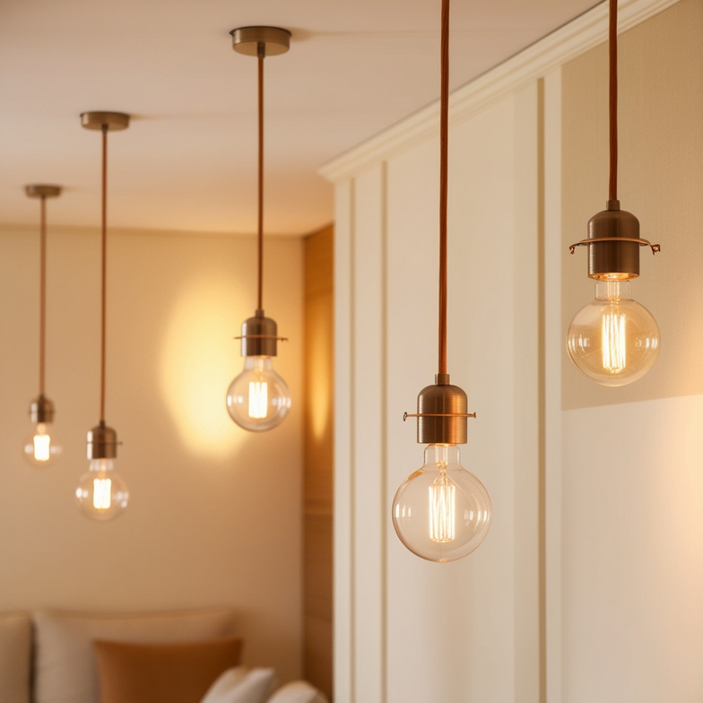




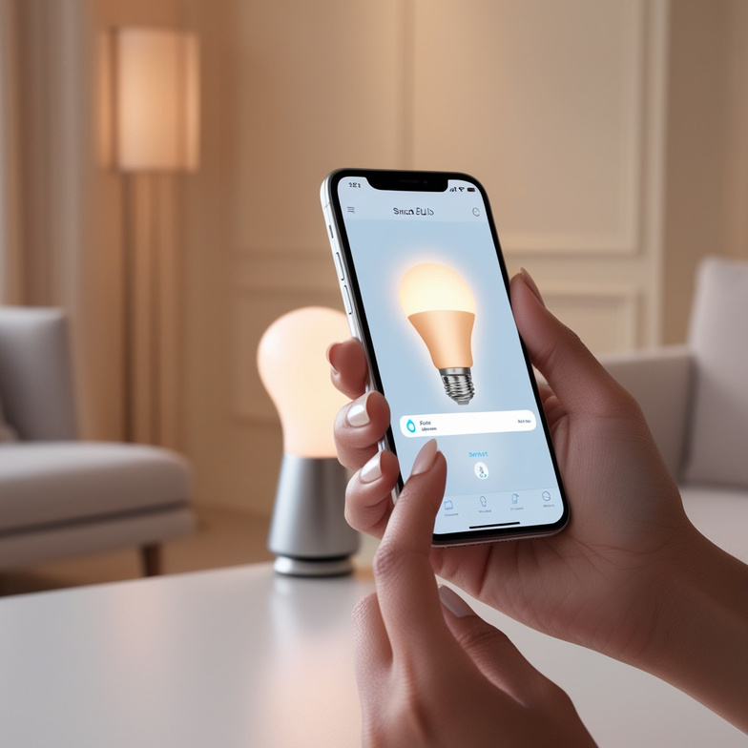

Smart bulb made easy with
Only 4 steps!
Download the app
Product of Spark07
Install the Adapter
Pair the bulb
Enjoy SmartGlow!
Plug & Play
Affordable
No wiring required!
Smart Glow
Contact Us
+94 76 130 0249
+94 74 288 5821
App control
Privacy
Smart light bulb adapter
Elevate your life with SmartGlow!

